Slide 1
Highways and words: Does isolation predict cultural homogeneity and distinctiveness?
Anjali Bhatt & Molly Lewis
June 30th, 2017
Summer Institute in Computational Social Science

Slide 2
Motivation
Methods
Findings
Next Steps

Slide 3
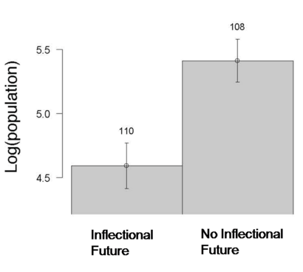
What are the sources of linguistic variability?
Linguistic Niche Hypothesis (Lupyan & Dale, 2010): Language systems adapt to their environments
Learnability pressures as one factor influencing the morphological complexity of a language
E.g., Languages spoken by many second-language learners should be structurally simper
Notes:
What accounts for this variability?
A A helpful distinction for thinking about this hypothis is different timescales
CORROLARY of this hypohties
This suggestsion --- that environmental pressures may shape language evolution – has been termed the LHN
A mechanism over multiple timescales
… and this might account for the variability across languages
* process of checking
translation for you. By detecting patterns in documents that have already been translated by human translators, Google Translate can make intelligent guesses as to what an appropriate translation should be.
This process of seeking patterns in large amounts of text is called "statistical machine translation".

Slide 4


Linguistic Niche Hypothesis
vs.
vs.
vs.
t
In-the-moment timescale (minutes)
(Nettle, 2012)
Notes:
Evidence for relationship between these pressures and features of language at many levels of linguistic structure (Atkinson, 2011; Hay & Bauer, 2007; Wichmann, Rama, & Holman, 2011; Bentz, Verkerk, Kiela, Hill, & Buttery, 2015; Lupyan & Dale, 2010; Bentz & Winter, 2013).
Density of speakers
Variability in speakers
Aspects of theobysucal environment
A helpful distinction for thinking about this hypothis is different timescales
A CORROLARY of this hypohties
This suggestsion --- that environmental pressures may shape language evolution – has been termed the LHN
A mechanism over multiple timescales
… and this might account for the variability across languages
* process of checking
translation for you. By detecting patterns in documents that have already been translated by human translators, Google Translate can make intelligent guesses as to what an appropriate translation should be.
This process of seeking patterns in large amounts of text is called "statistical machine translation".

Slide 5

What explains within-language variation?
“Code-switching”

Slide 6
Can highways be cultural connectors?
Hypothesis 1: Towns further away from highways are more linguistically homogenous
Hypothesis 2: Towns further away from highways are more linguistically distinctive from each other
Highways as operationalization of migration (movement of people)

Slide 7
Motivation
Methods
Findings
Next Steps

Slide 8
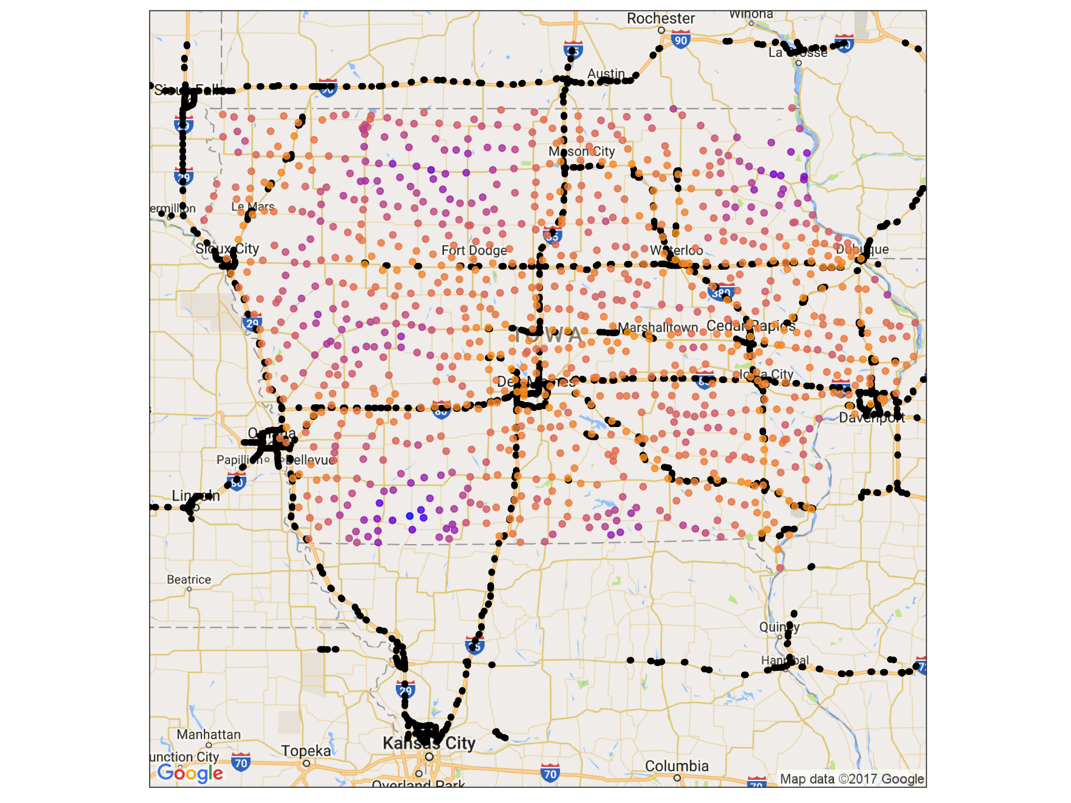
Iowa as a pilot study
Highway exits from OpenStreetMap (includes nearby exits outside of Iowa)
946 incorporated cities in Iowa, excluding Des Moines
Driving time to highway ranges from 2 to 83 min (median of 20 min)
NEED PLOT LEGEND

Slide 9
Text from Google place reviews
REDO PLOT
Fetch all reviews for establishments within a 5km radius of city centers
24,469 total reviews
Retain 546 cities with at least 5 reviews
Add example reviews

Slide 10
Demographic data
xxx
Add that we got demographic data, show demographic maps (and plan to add it into our analyses)

Slide 11
Motivation
Methods
Findings
Next Steps

Slide 12
Linguistic features

Slide 13
Emotion and distance
Positive Sentiment: r = .13
Log. Prop. Exclamations : r = .1
Log Prop. Capitalization: r = .15

Slide 14
Within-town linguistic diversity
Is town x more variable linguistically than town y?
Multiple levels of variability
Vocabulary
Topics
Usage patterns
How to measure this?
Type-Token Ratio: Number of distinct words in each “corpus” ( = town)
But, not measure of within-town variability
Highly correlated with length

Slide 15
Linguistic Distinctiveness (between towns)
We have yet to do…

Slide 16
Motivation
Methods
Findings
Next Steps

Slide 17
Future Directions
Account for
Demographics
Content variability (e.g., only examine Subway ® or pharmacies)
Variability in # reviews
Different measures of linguistic diversity
Different measures of migration/movement
Inflow and outflow in cities (e.g., Craigslist ads)
Employee movement between organizations
Gentrification patterns

Slide 18
Appendix

Slide 19
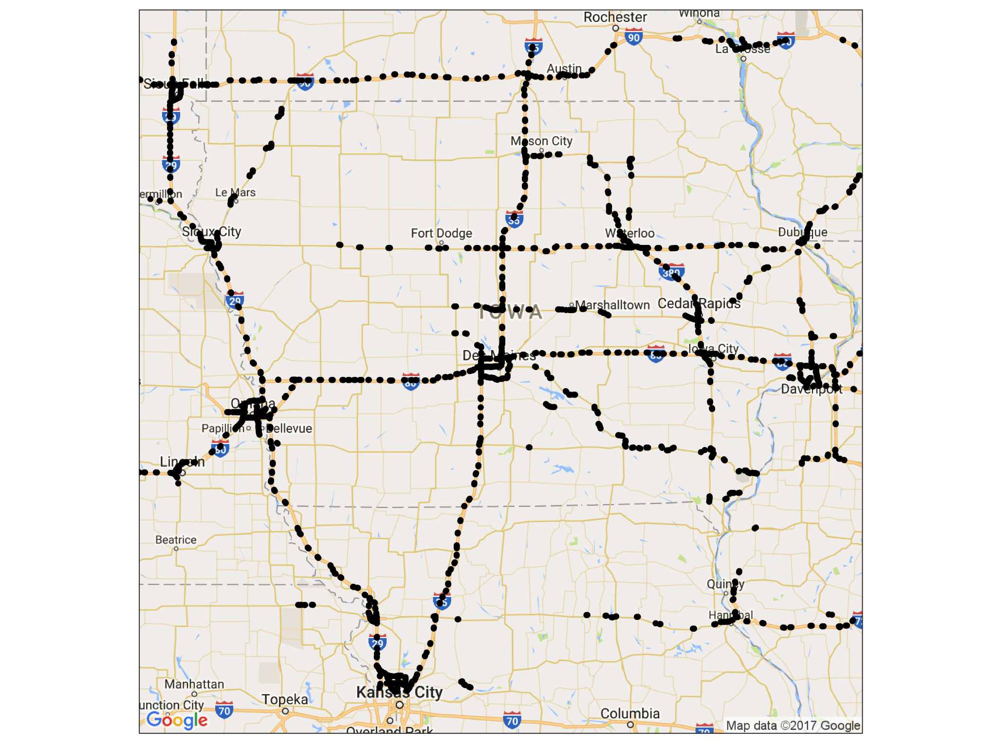
Highway Exits

Slide 20
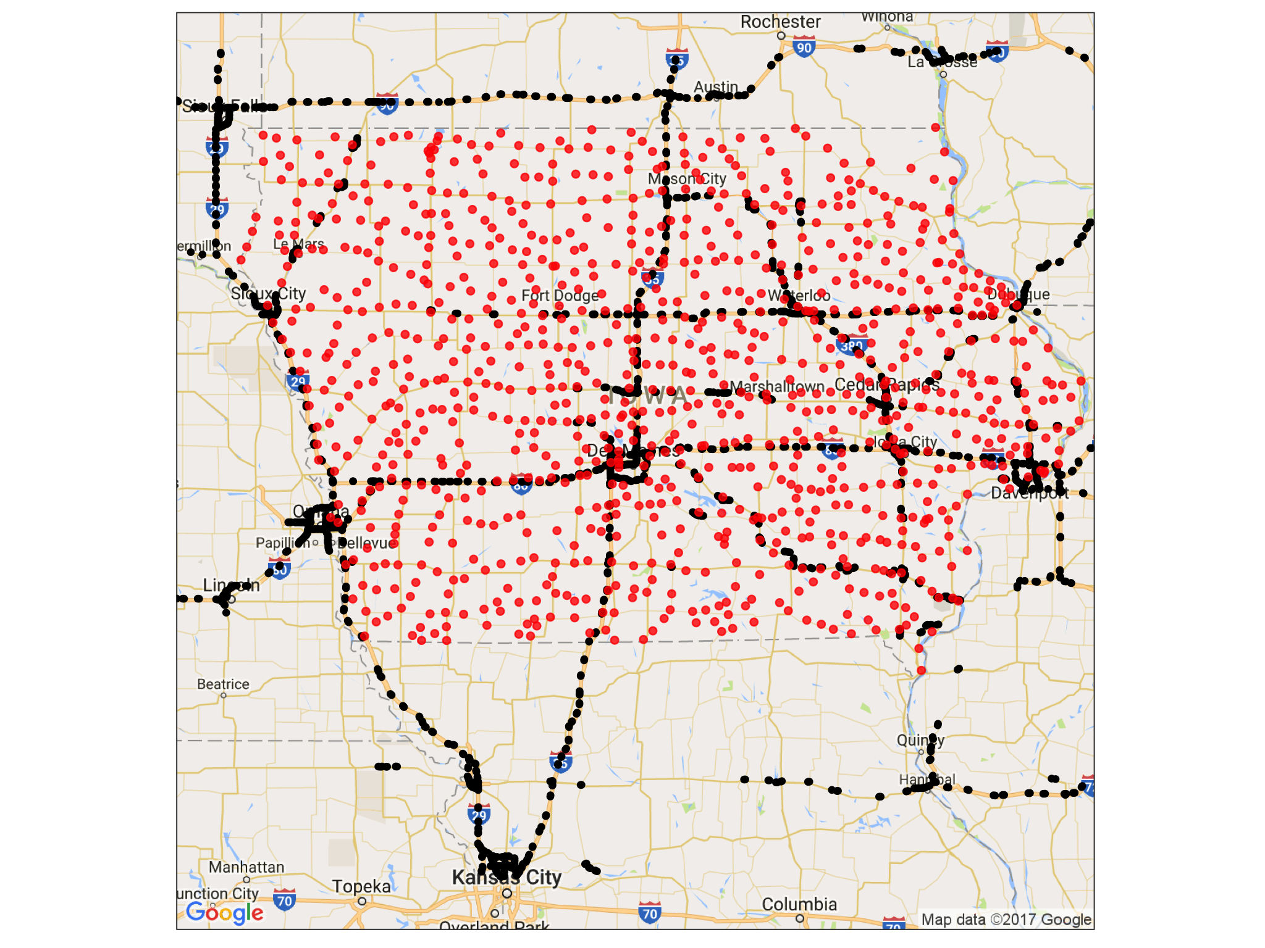
Towns in Iowa

